Slide 1
COVID-19
Stan Roodman, Ph.D.
Layout and design: Stella and Allison Roodman

Slide 2
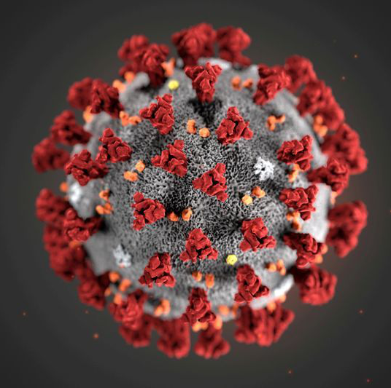
Outline of Talk
Virology
Coronavirus
Immunology
Clinical course
Vaccine Development

Slide 3
The novel coronavirus is a master of disguise: Here's how it works

Slide 4
Name of Disease/Infection
COVID-19 = Corona Virus Disease discovered in 2019
Name of Virus
SARS-CoV-2 = Severe Acute Respiratory Syndrome CoronaVirus-2
Second such kind of infection known
80% similar to SARS-CoV -1
96% similar to a BAT coronavirus and 4% Pangolin
bats have 1700 CoVs

Slide 5
Corona Viruses in Humans
Known Human Coronaviruses | Year | Number Infected | Number Died | Percent Died
SARS-CoV from Civet & Racoon Dogs in Foshan | 2002-3 | 8100 | 774 | 10%
MERS-CoV from Camels (Middle Eastern) | 2012 | 2494 | 858 | 35%
SARS-CoV-2 2019 from Bats in Wuhan | 2020 worldwide | 23,685,000 | 814,000 | 3.4%
SARS-CoV-2 2019 | 2020 USA | 5,736,000 | 177,500 | 3.1%
HcoV-OC43(cattle), -229E (camels), -NL63: causes 30% of common colds | Every Year | 90% of all people have Abs

Slide 6
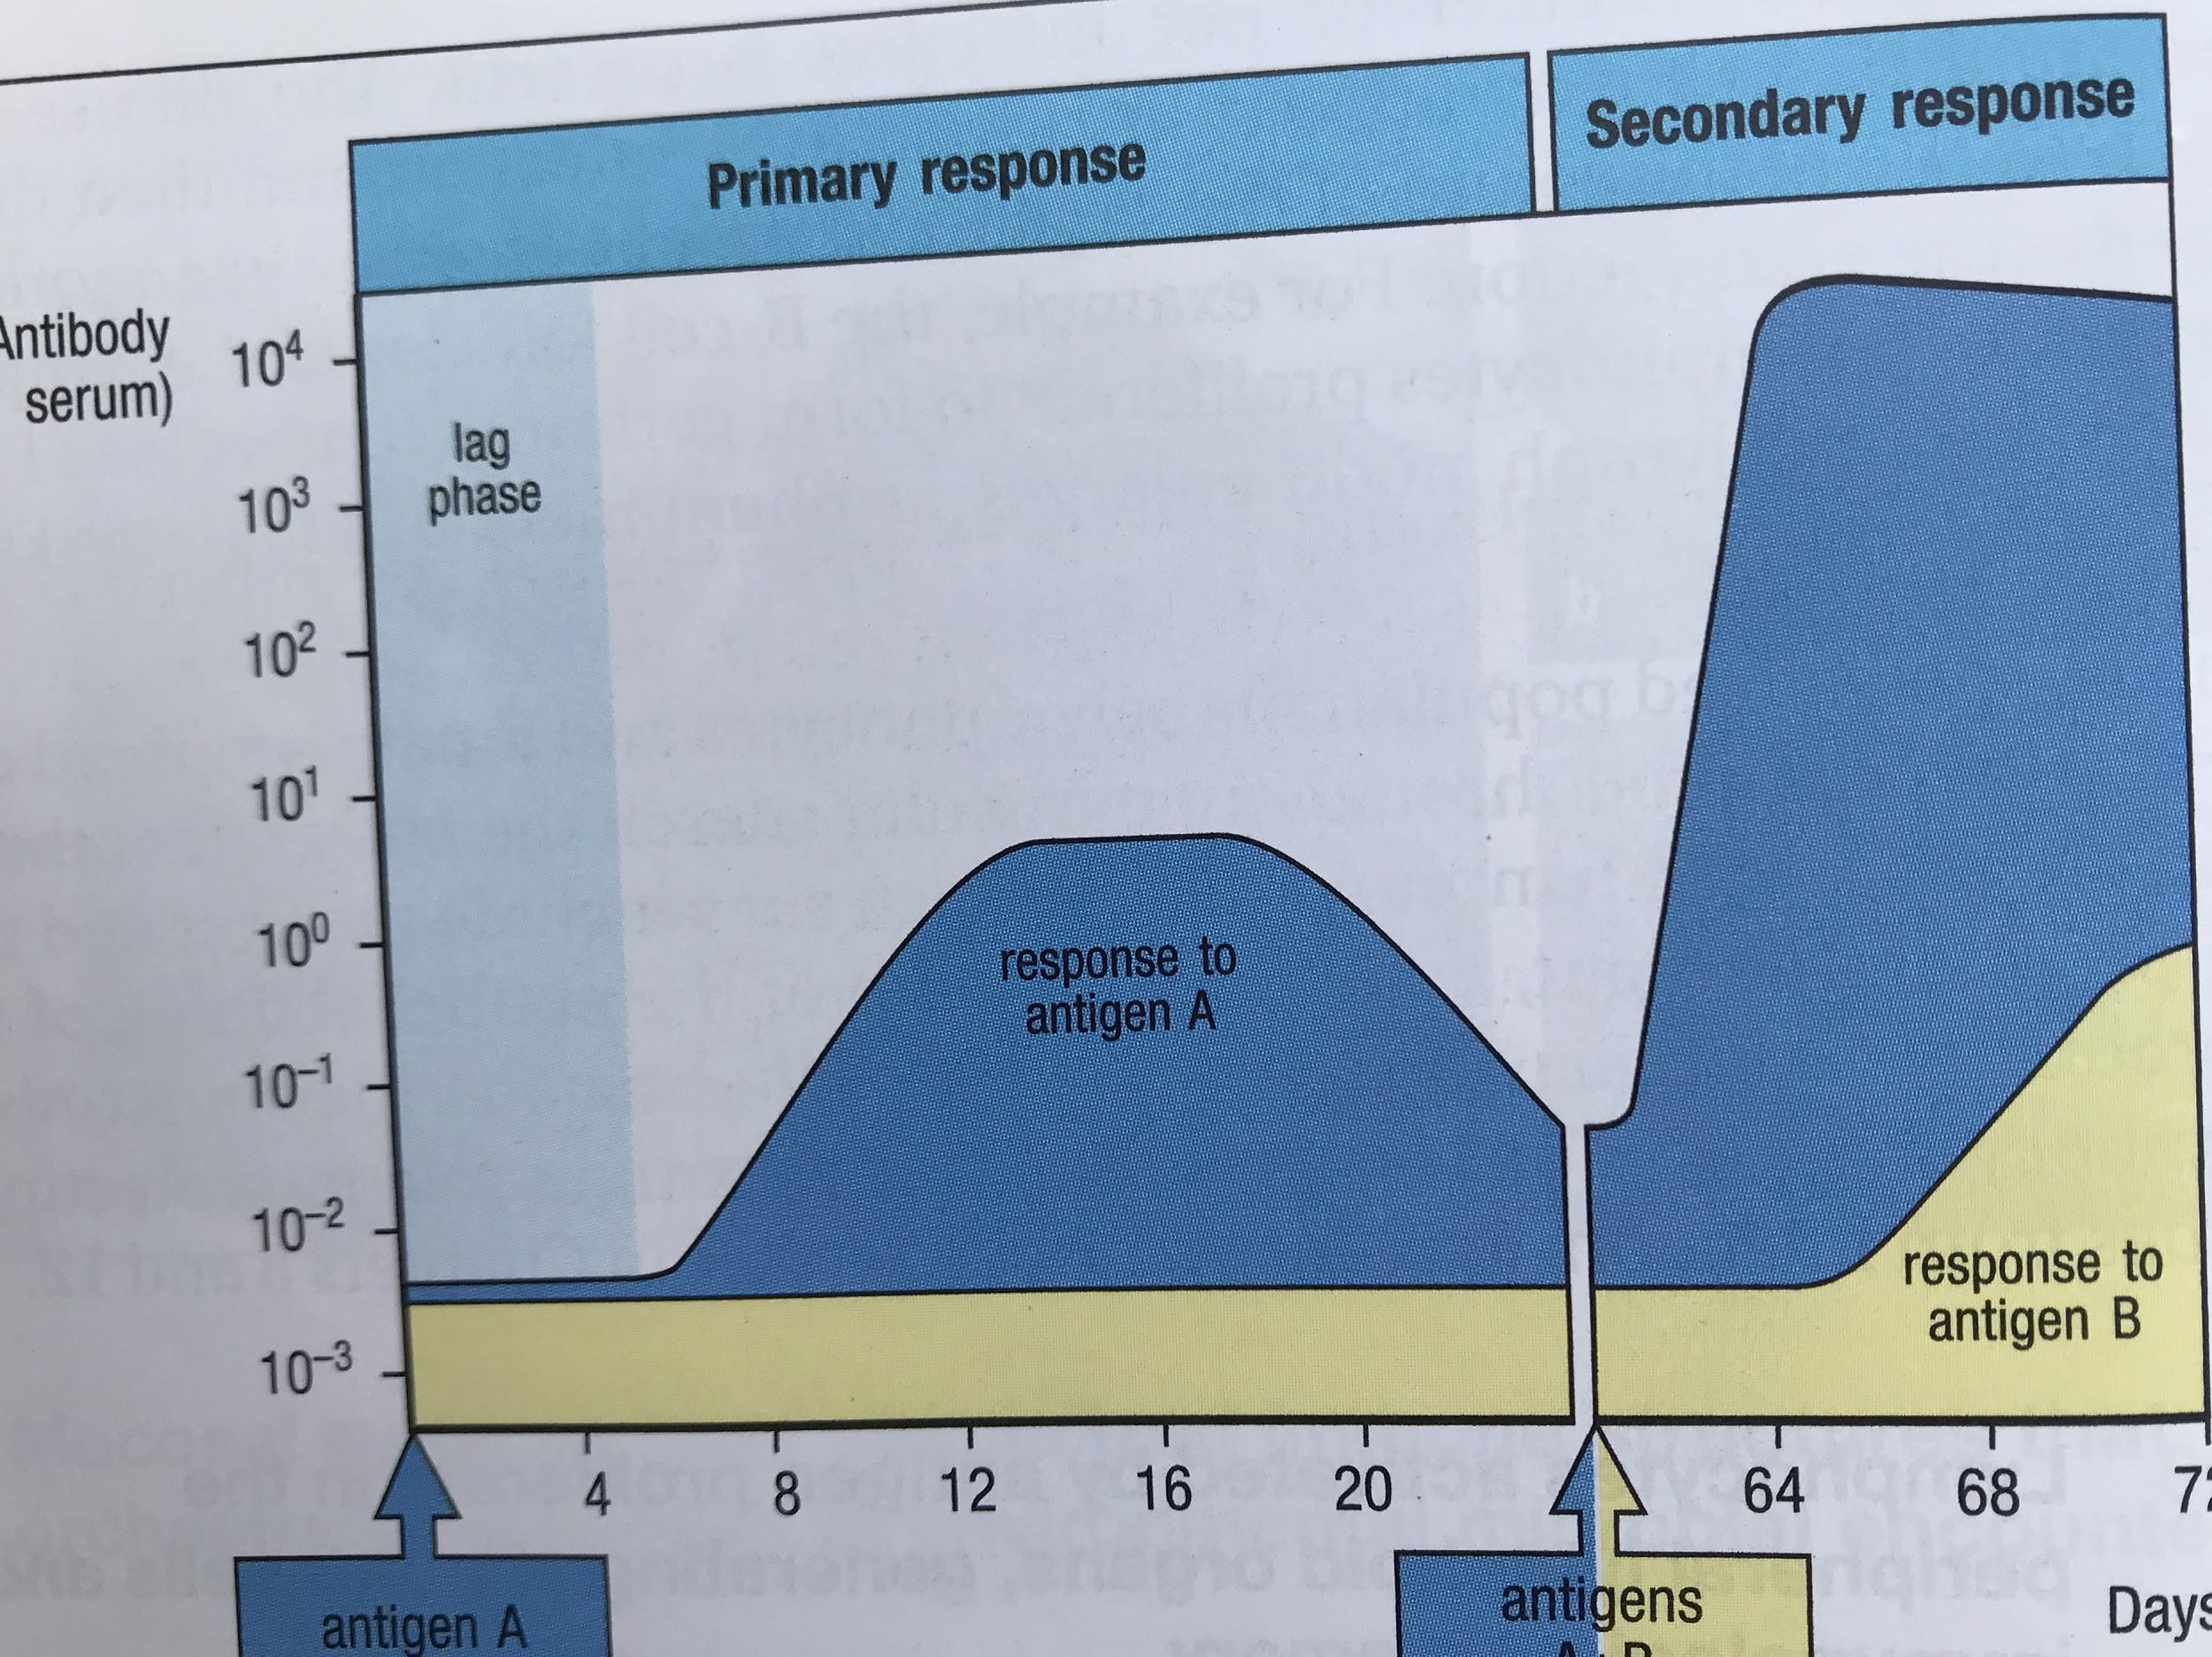

Slide 7
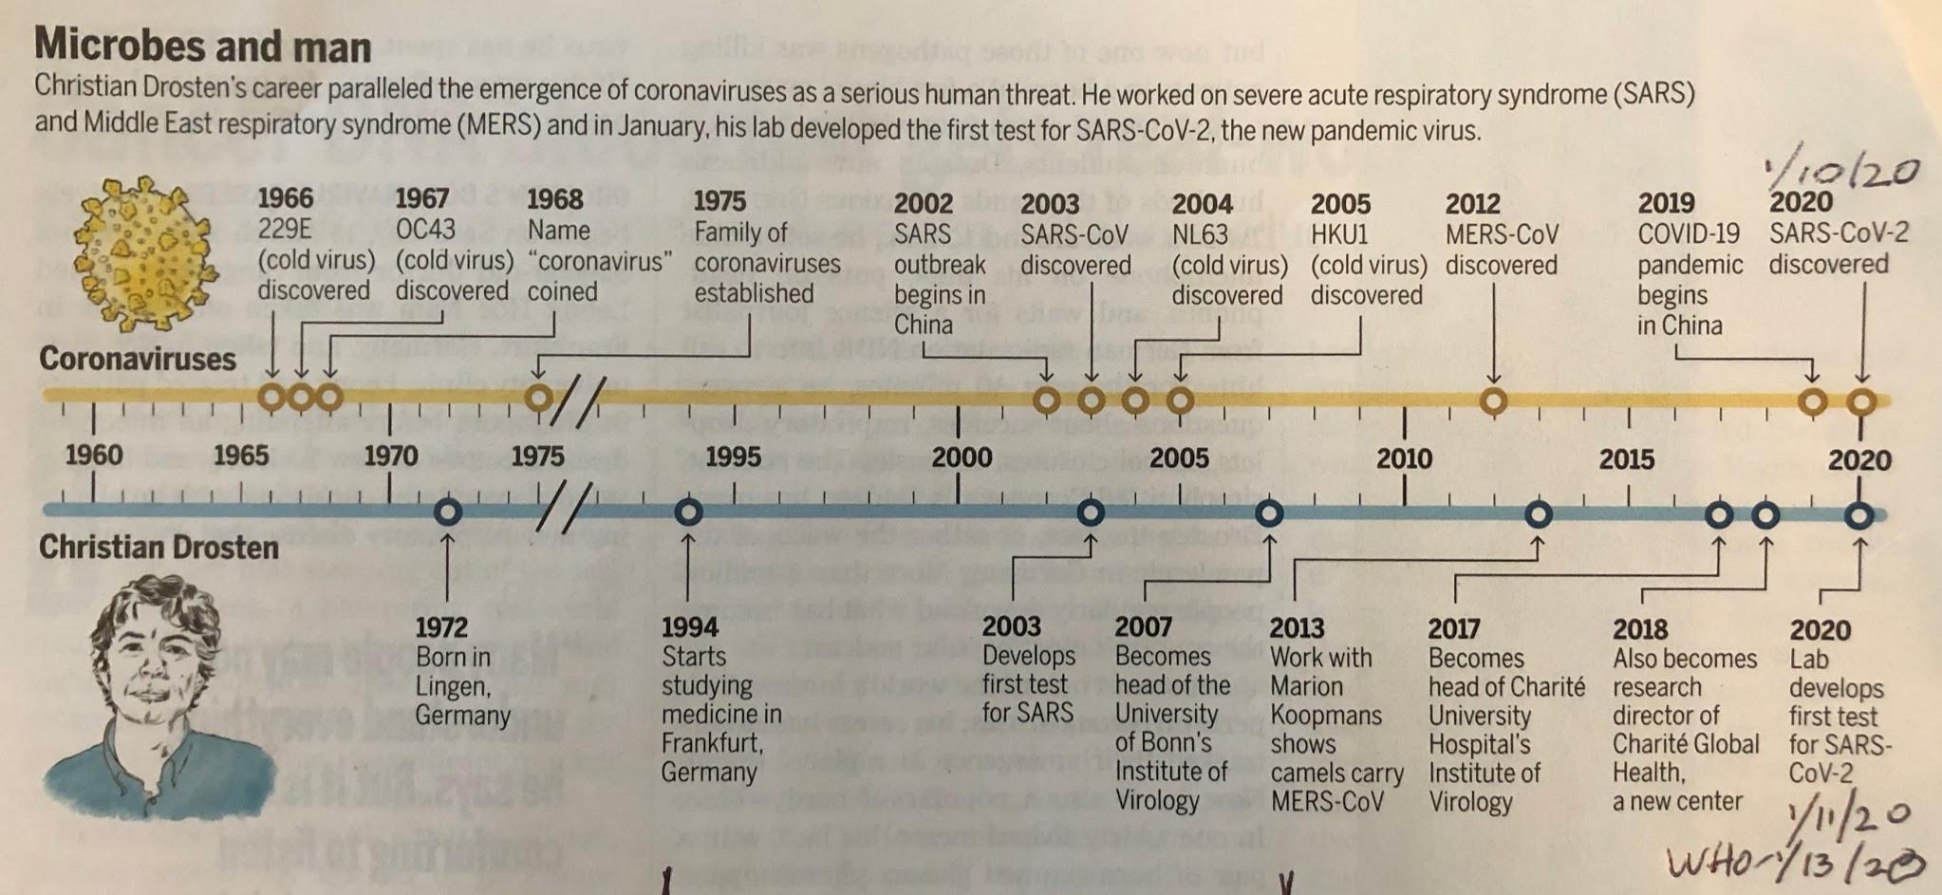

Slide 8
Virus Characteristics
Non living as can be crystallized
No cells, no energy input -food intake
No waste products out
Extreme specificity for invading host cell
Only potential to replicate and kill host cell
One virus in, 100-1000 out

Slide 9
Virus Composition
Genetic material DNA or RNA
Coat around genetic material
Coat (envelope, sometimes) is made of lipids so can fuse with cell lipids- major class
Some Enzymes within Coat from Last Infection
Proteins on outside of envelope used for Attachment to Specific Sites on Host Cell

Slide 10
Characteristics of Coronavirus Co-V2
Has 30,000 bases (E.coli 3M, Humans 3B per cell)
Is Single Chain RNA ( Positive Chain)
96% RNA similar to BAT virus, 4% Pangolin; 80% similar to SARS-CoV
Virus has only 4 proteins in it (very small number)
Spike protein is key for entry into cell & target for Antibody(Ab)
Virus makes 16 other proteins required for assembly
Can infect dogs, cats, hamsters, chickens, mink, tigers, monkeys
cows

Slide 11
How COVID-19 Enters a Cell
Spike protein (S) on outer part of virus must be cleaved
Spike Protein Binds to a protein on cell surface called Angiotensin Converting Enzyme (ACE-2)which normally cleaves Angiotensin
But here the Converting Enzyme just by chance recognized the Spike Protein also and cuts off part of the Spike protein
Better way to describe: Spike protein just by chance changed so that now could be cut by Converting Enzyme
GET INTO CELLS BETTER (10X!) & INTO MORE KINDS OF CELLS

Slide 12
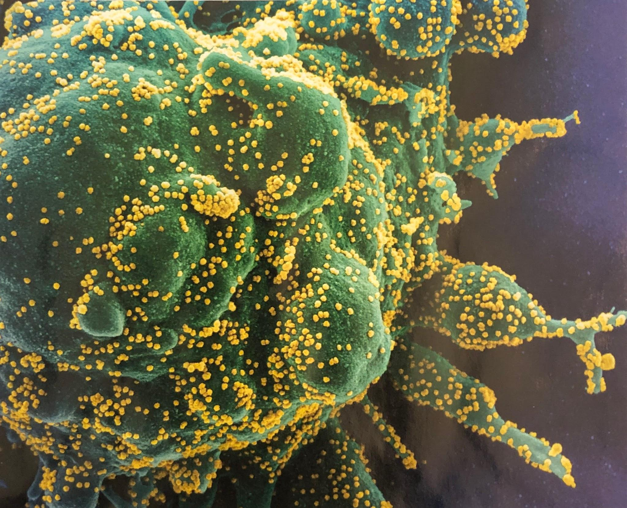
SARS CoV-2 in yellow
T Cell in green

Slide 13
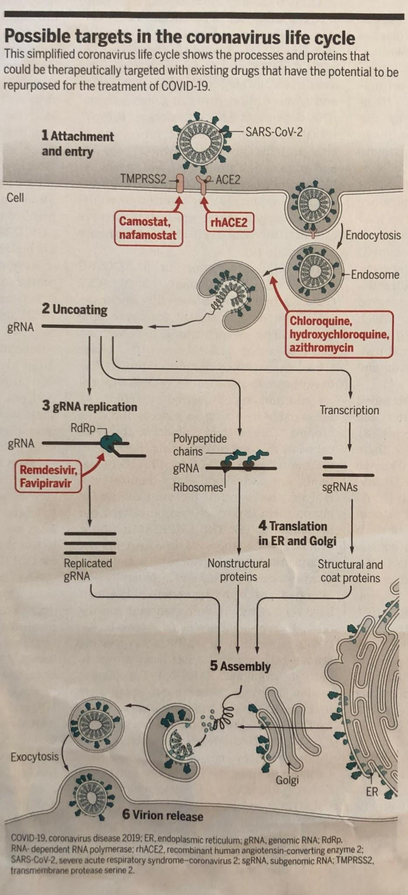

Slide 14
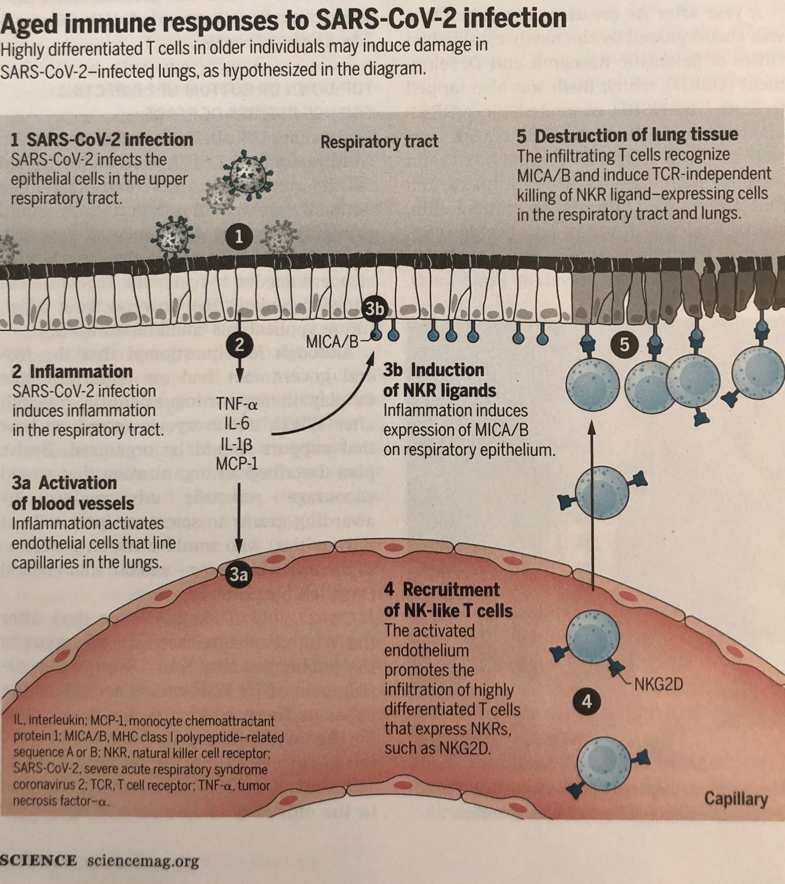

Slide 15
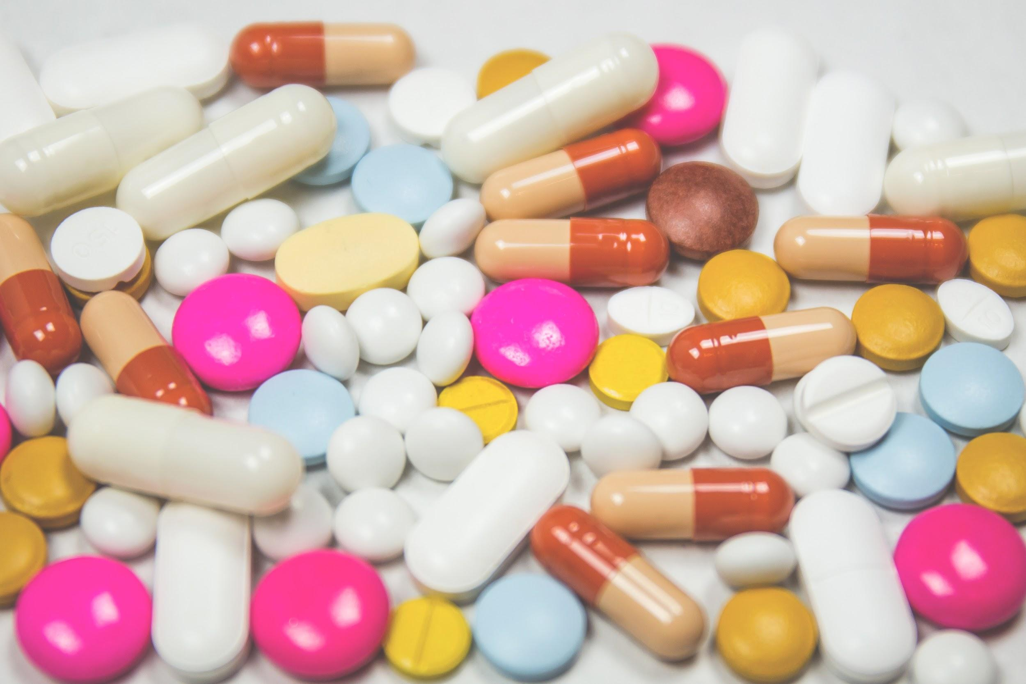
Drugs for COVID - Not Working
Hydroxychloroquine for Malaria
Ritonavir & Lopinavir for HIV (AIDS)
100,000 other drugs and chemicals
Hydroxychloroquine for Malaria
Ritonavir & Lopinavir for HIV (AIDS)
100,000 other drugs and chemicals

Slide 16
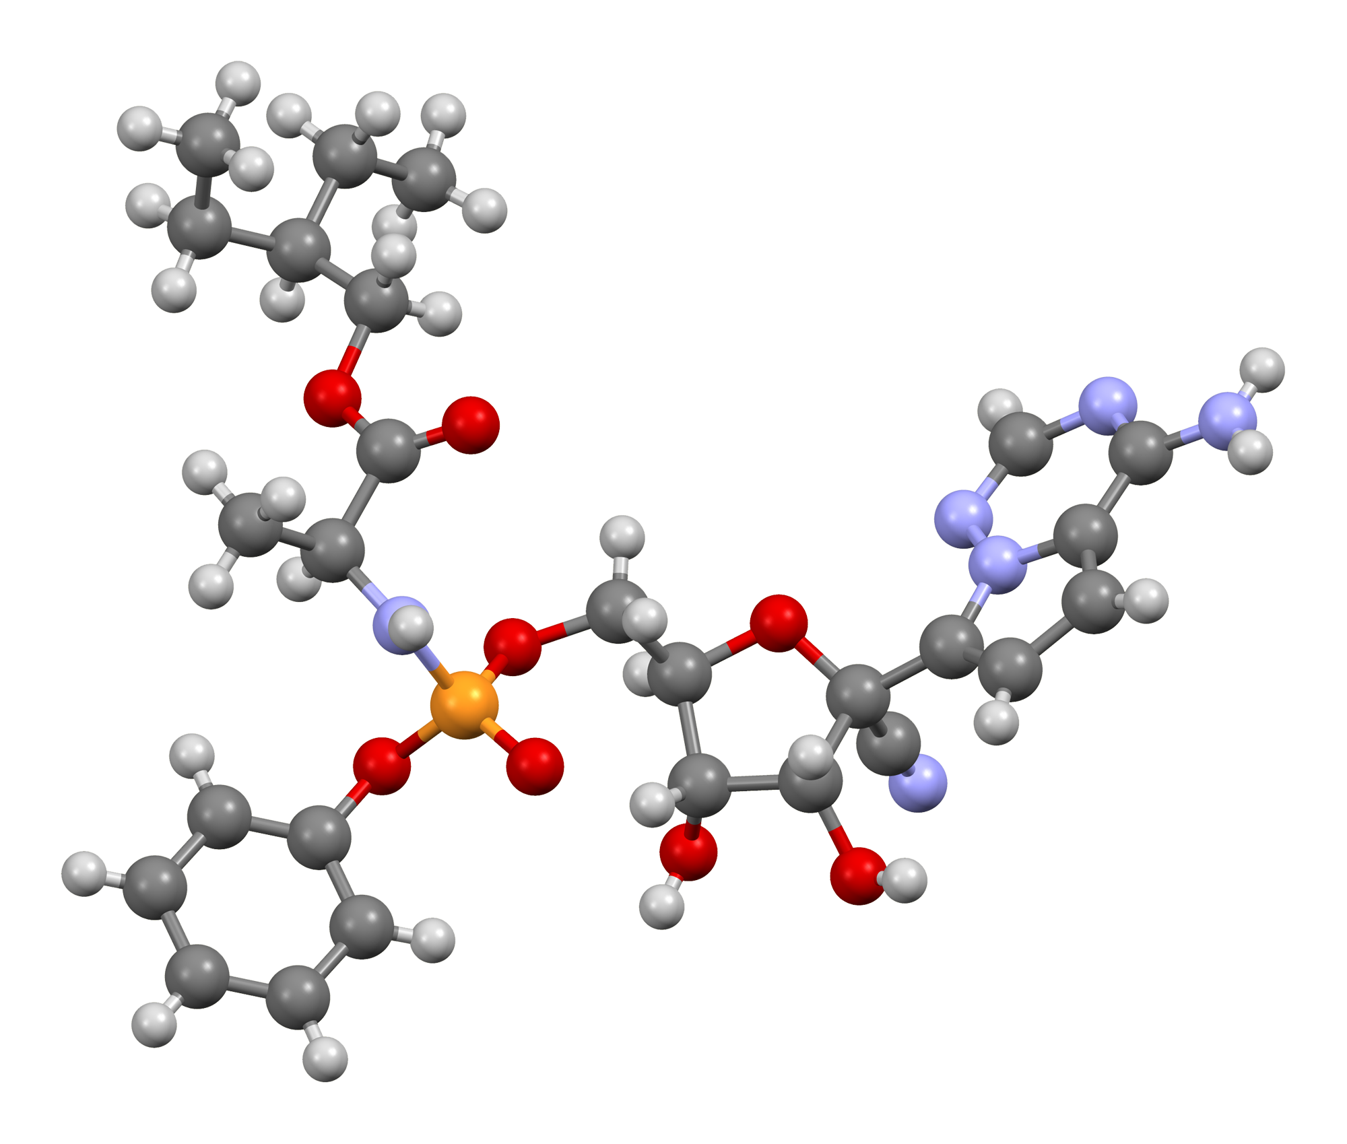
Drugs for COVID - (Somewhat Effective)
Remdesivir (iv)
For Ebola
Pts recovered in 11d vs 15
Dexamethasone, hydrocortisone (steroids)-Meta Study
Reduced deaths 20% of patients on ventilator (40% die to 33%)
Inhibits immune system
Interferon beta (nose drops)
Protected 2500 Chinese doctors
An Interleukin secreted by immune cells to fight viruses
Nonspecifically (IFN beta used for MS,certain cancers,Hepatitis)
Must be given early in infection, otherwise will exacerbate

Slide 17
Medical Course of Infection
Serious Complications - 20% ; 30-40% Never develop any Symptoms
Small droplets from Infected person breathed into lungs
Virus enters lung cells and replicates rapidly, fluid in lungs
Cells die causing immune response, pneumonia, blood clots*
Lungs collapse making breathing difficult, blue Lips, confusion
Oxygen capacity decreases, shortness of breath, oxygen required

Slide 18
Medical Course of Infection - Continued
Fever/chills, cough/sore throat, headache, loss of smell & taste*, fatigue, nausea/vomiting, chest Pain*, body Aches
Virus infects gut cells leading to diarrhea, GI hemorrhage
Oxygen therapy, ventilator, Acute Respiratory Distress Syndrome
Brain Fog, Tremors
Complications: Respiratory Failure, Blood Clots, Septic Shock Heart, renal & liver failure- long term effects - UNKNOWN
In Italy, Hospitalized Pts. 87% still struggling 2 months later
US, UK & Sweden, 15% long term problems(#62)- Fatigue Common
Plan: UK study of 10K Pts for up to 25 years

Slide 19
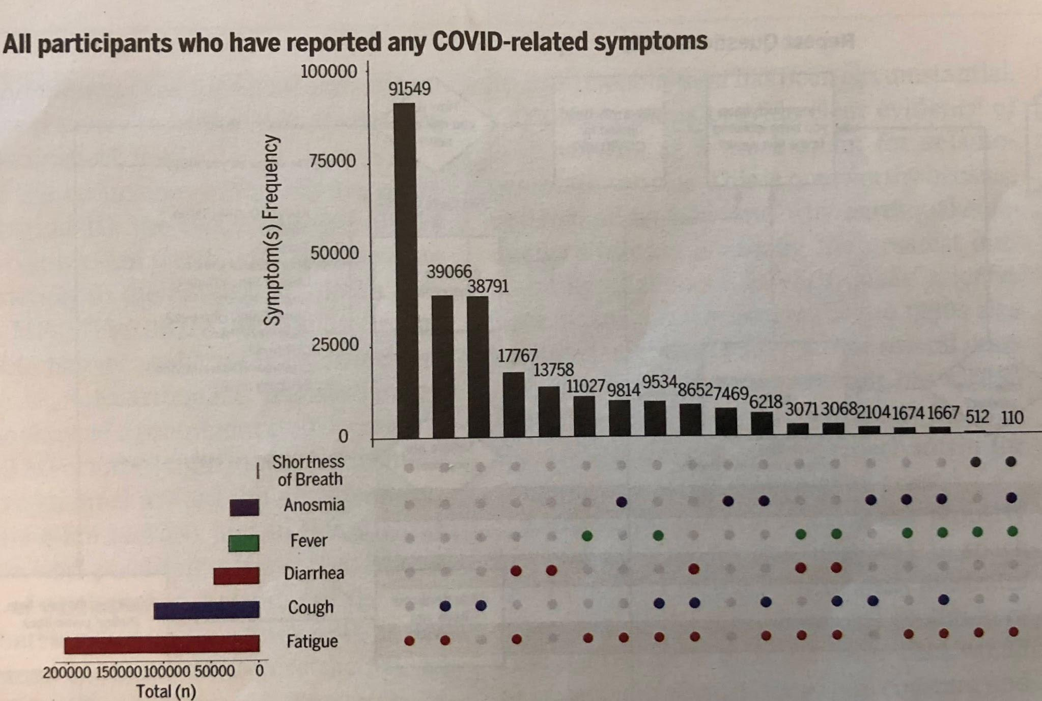

Slide 20
COVID-19 vs. FLU
 | COVID-19* | FLU
Post infection: Symptoms | 2d to 14d | 1d to 4d
Infectious | -2d before symptoms to10d (CDC): others 17-20 d | -1d to 7d
Ease of Spread | Very Easy | Less Easy

Slide 21
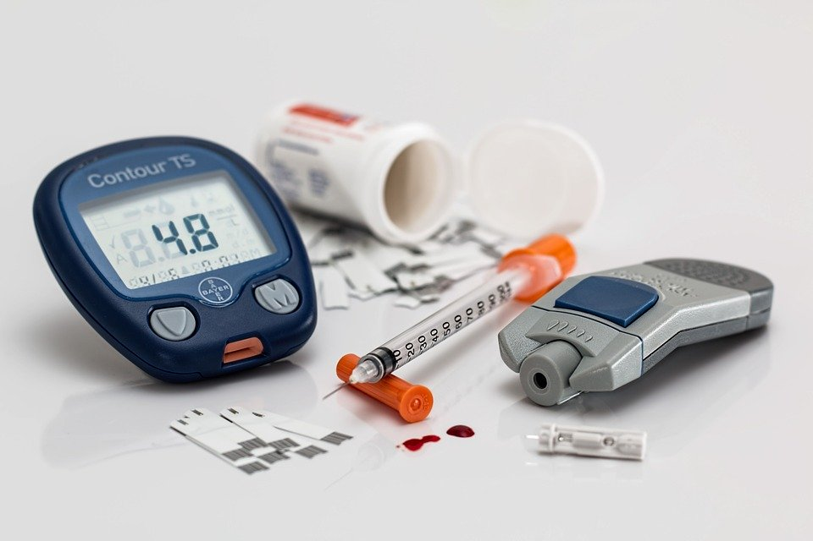
Comorbidities - Covid 19 & Another Condition
Diabetes
poorly controlled - 29% die
well controlled - 6% die
Pregnancy- increased severe reaction & ICU
30% Hospitalized vs 6% all persons, 1% fatal
Cancer
Increases risk of death x3 as compared to non-cancer patients
Increases severity - ICU & Ventilators
28% fatality with Cancer vs 14% without -For all age groups
Age: Sonoma C. 80% deaths over 65y: US 40%; 15% from senior care .fac.
Males worse outcome than females(better T cell response, less Innate-8/26/20

Slide 22
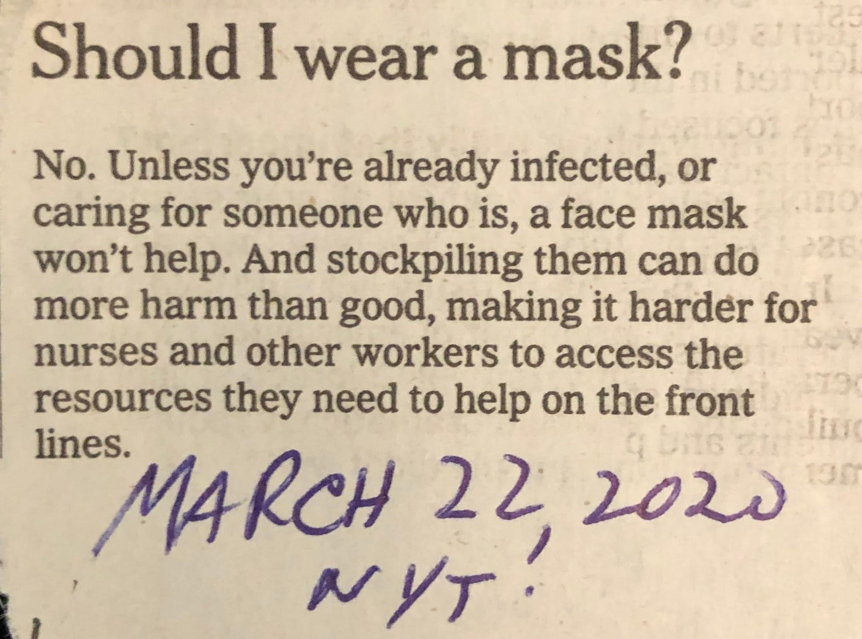

Slide 23
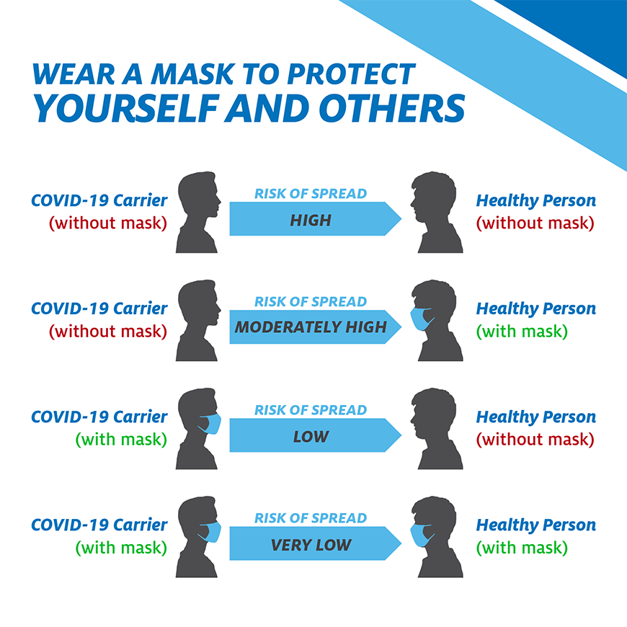
Transmission of the virus with and without masks.

Slide 24
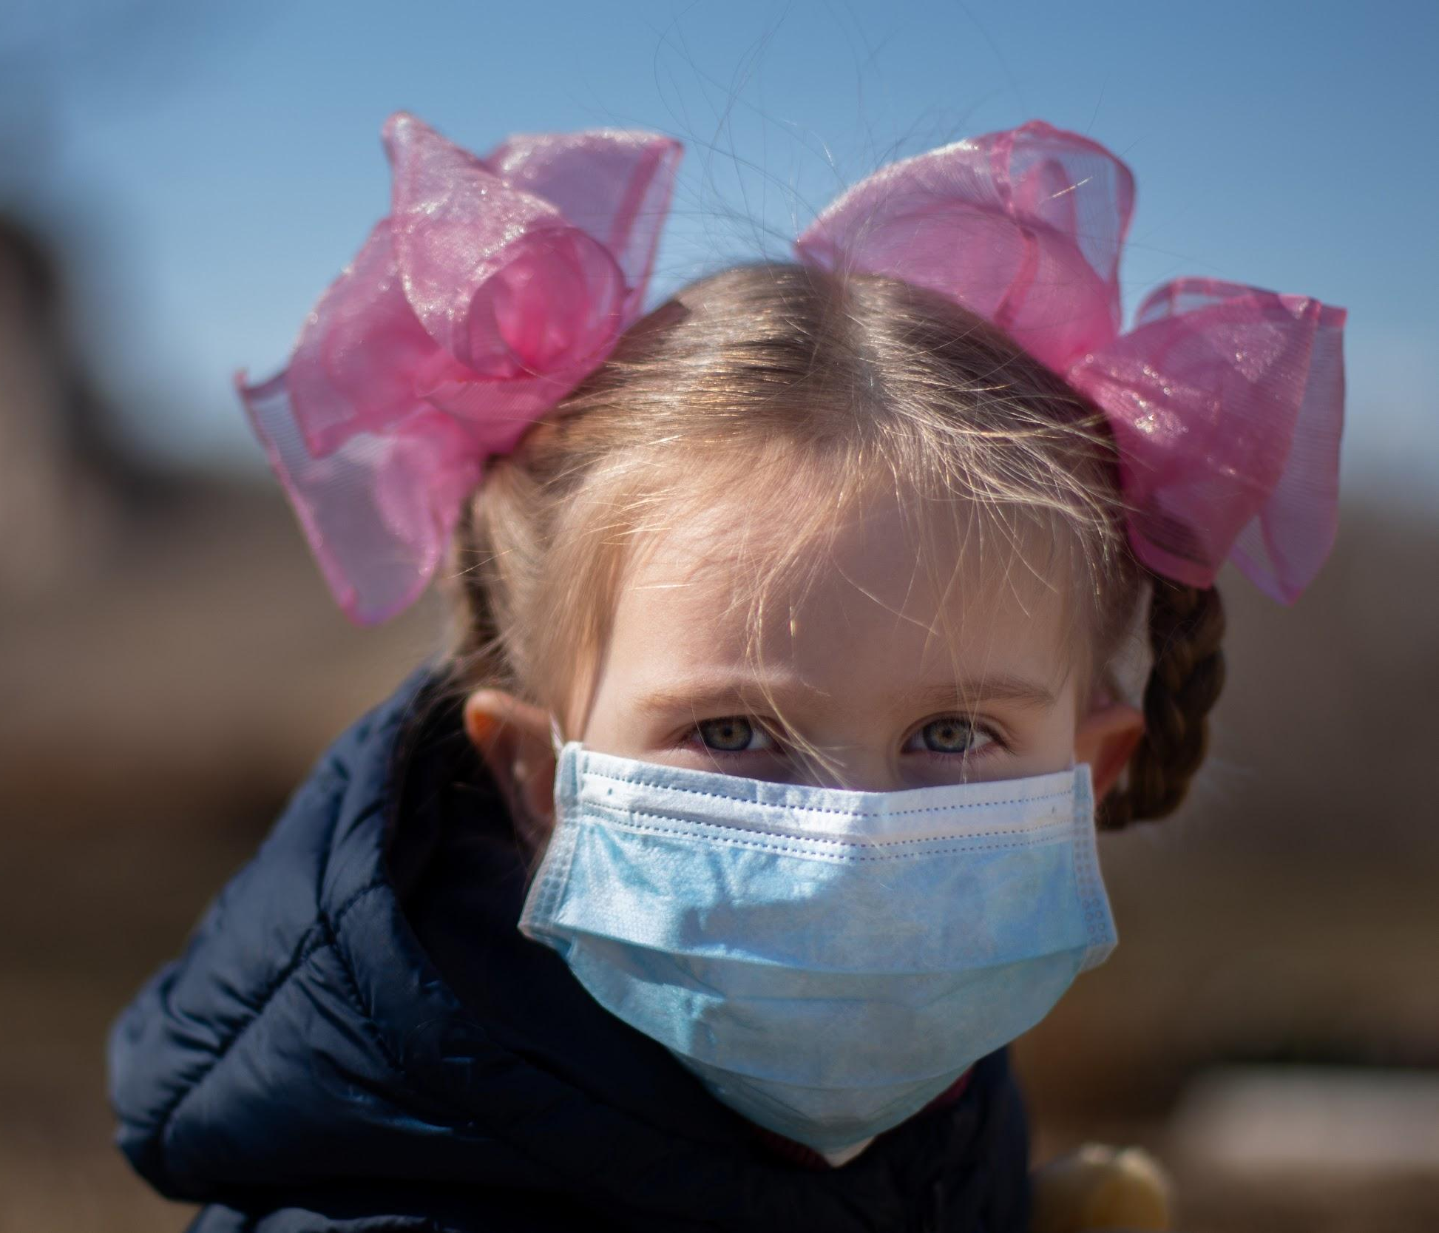
COVID-19 in Children
Cases (children under 17)
United States - 9.1% of all cases (400,000 but underreported)
Sonoma County 15% of cases , range 4-18% in states
Deaths (children under 17)
90 (or 0.06%% have died out 160,000 US total ) or 0.02% of infected children)
Hospitalizations
1/20 of adults
Symptoms - none or mild for most
Notes:
Needs to be changed before each presentation so the statistics are accurate

Slide 25
COVID-19 in Children (Continued)
South Korea Study (Best available)
65,000 persons
10-19 year olds as infectious as adults
< 10 years - transmit infection less (but not zero)
Multisystem Inflammatory Syndrome (MIS-C)- 300 in US, 5 died
Fever + Rash + Heart problems + Another Organ= Cytokine Storm
Long term effects from any infection = UNKNOWN
Wash DC: Test 1000 kids, of Latino 40%+, 30% Black, 10% white

Slide 26
COVID-19 in Children - YMCA camp in Georgia
CDC Reports on July 31
In-person camp from June 17-27
All campers tested negative within 14 days of camp start
Campers did not wear masks
One counselor got sick - sent home after 1 night (later tested positive)
260 out of 344 tested campers tested positive

Slide 27
COVID-19 in Children - YMCA camp in Georgia
Who tested positive?
6-10 year old campers - 51%
11-17 year old campers - 44%
18 - 21 year old staff - 33%
22 - 59 year old staff - 29% +(2 of 7)
Who had symptoms?
136 of Campers/Staff who tested +
26% had none,
74% had some (65% fever, 61% headache, sore throat 46%)
Asymptomatic Transmission
Did not look at family members at home after return

Slide 28
Antibody (Ab) Therapy
Test population for Abs to SARS-CoV-2 to determine actual incidence of infection. If Positive means in process or finished fighting infection
Test all hospital admissions, people getting any lab work, people across all US
Find actual infection rate is 6-24 times higher than that from looking at current virus results (for SF 9X).
So many more people were infected but didn't know it or had some symptoms but thought it was something else.
THESE UNKNOWINGLY INFECTED PERSONS TRANSMITTED CORONAVIRUS
If have Abs to SARS CoV-2, then immune to reinfection (3 exceptions so far)
will have Memory B Cells ( will make Ab upon reexposure)
memory T cells (required for B cells to make Ab)
other T cells which can kill CoV Infected cells

Slide 29
Antibodies for Therapy -0.75B from US
Convalescent Plasma(used earlier for both CoV pandemic):
Test recovered patient's plasma (blood minus all cells)
Find those with highest amount of ANTIBODY(Ab) to Virus
Give plasma to patients so Ab can stop infection, decrease deaths
Isolate Blood B Lymphocytes from High Ab Producer
B Cells = Cells which actually make and secrete Ab
From one cell, move genes for Ab into Embryonic cells which can grow forever and secrete large amount of Ab & that Block Infection
Purify and be given as Therapy for Prophylaxis or to Treat
Called Monoclonal Ab(MAb) Therapy- drug name ends in mab
Test on +/- infected, +/- symptoms, sick +/- in hospitals
Several companies in Phase 3 in 5000 persons, cost 1-10K/p

Slide 30
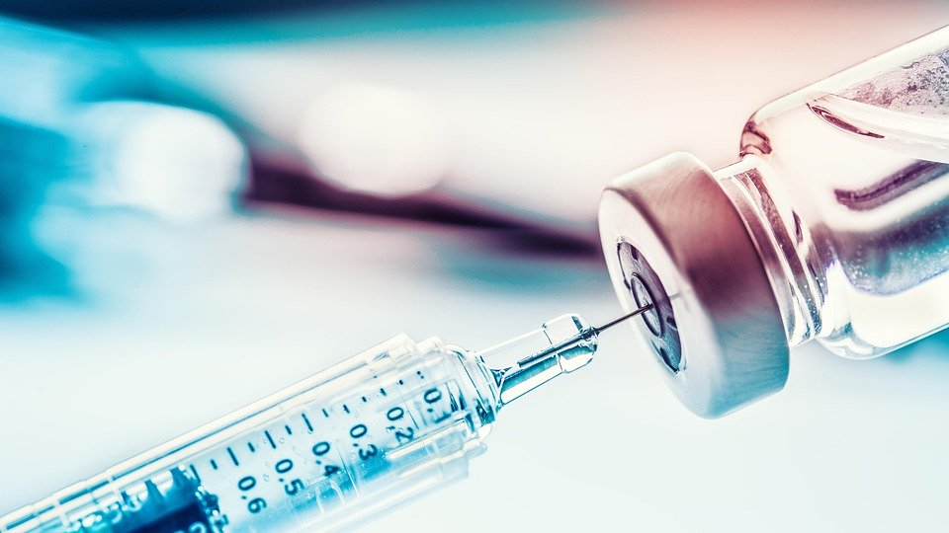
Vaccine Potency
Type of Vaccine | Lasts
Polio, Hepatitis A, Yellow Fever | Lifetime
Tdap (Tetanus, Diphtheria, Pertussis) | 10 years
Meningitis, Typhoid | 2 years
Flu | 1 year

Slide 31
Vaccine - The Race is On
USA : OPERATION WARP SPEED- $10 Billion
WHO Access to COVID-19 Tools (ACT) - $8 Billion (non US)
WHO COVID Vaccine Access =COVAX 170 countries Coop share vaccine
250 Companies are working on Vaccines worldwide
Salk Polio Vaccine 1947-1955 - Inactivated killed virus:
Salk grew polio virus (not the first to grow)
tested chemicals which would kill virus but still cause antibodies to develop in animals, then test in kids!
Do same for Covid-19
Chinese report working vaccine in monkeys (July)
Make Neutralizing Ab & Monkey Challenged with Virus now resistant
Now testing vaccine in humans in Brazil as not enough cases in China
Aug 20: Using vaccine on medical workers & others under Urgent Use

Slide 32
Vaccines - Attenuated but Live Virus
Sabin Oral Polio Vaccine (OPV) - 1960
Grow virus in different cells till it loses infectivity but still causes antibody to be made.
Measles Vaccine (Took 9 years to develop 1954-1963): Shingles
Develop Mucosal Immunity- No one doing same for Covid-19
These vaccines provide immunity to Unrelated Viruses!
OPV: Reduced flu deaths by 75% 1970's; increased healing in genital Herpes
In Africa reduces all deaths in 0-5 year olds by 19%
Gallo proposes infecting people with the Corona cold viruses or OPV to see if they give CROSS-REACTING Immunity

Slide 33
Vaccine - Recombinant Virus
Use only part of Genetic Material of virus so can't cause any infections
Example: Hepatitis B Vaccine
Use small portion of Coronavirus as part of a defective Adenovirus so can't cause either disease but gets into cell and starts making viral S protein
Development Group:
Univ. of Oxford (working on making vaccine to other Coronaviruses)
AstraZeneca - $1.2 Billion
To make 100 million doses, grow virus in HEK 293 cells (kidney cell from fetus aborted in '72) - problem for US Catholics but not Vatican(2005 & 2017)!
Others using same method: Janssen(J&J) & Beijing Inst. BioTech

Slide 34
Vaccine Adenovirus (Oral)
Vaxart, a South SF Company of only 15 employees
Only Oral Vaccine and Room Temperature Stable!
Tested a Flu–Adenovirus vaccine coated pill (1x) in humans and challenged with Flu and were protected!
Coated pill released in small bowel where makes Ab
Mucosal immunity (IgA) is key to respiratory control
Coronavirus vaccine pill should work too
Spike gene + a few other Corona genes with Adenovirus
Tested in animals = make anti-SARS CoV-2 Abs in 2 weeks
Start Monkey challenge tests June 26;
Human trial late summer
Will make 1Billion doses

Slide 35
Vaccine- Another Recombinant Trial
Israel published vaccine trial results- August 1
Use part of Spike gene recombined with a different virus (VSV)
Hamsters need only 1 dose to make Neutralizing Antibodies and protect against challenge COVID-19
lungs virus free
Testing in humans Phase 1-2
Another idea: Inject DNA or mRNA of the antibody genes to SARV-CoV-2 directly into people so cells make Ab directly($100M)

Slide 36
Vaccine - New RNA Method
RNA Method Never been used before as a Vaccine
Use RNA of virus spike protein only as vaccine - By injection
Moderna (Biotech by MIT professors 10 years old - no products yet)
Will vaccinate 30,000 US Nursing homes and other high risk sites to see if rate of infection is reduced compared to controls (started July 27)
Received $0.53 Billion to produce 300 Million doses before vaccine proven effective
Definition of Success = Prevent Infections totally or partially
or maybe just mild or less severe illness

Slide 37
Vaccine New RNA Method Variation
Use mRNA of spike protein in lipid nanoparticle by injection
Developed by German company: BioNTech with Pfizer as partner
Results in Human trial Phase 1 & 2
High levels of Neutralizing Abs to virus (higher than convalescing Pts!) and had T cells which recognize virus also
Need 2 doses, no side effects
Human trials in 30,000 persons start end of July
Goal 300 Million doses before approval
1Billion doses by end of 2021

Slide 38
3 Tests for COVID-19
1. Virus RNA- Assume RNA present means it is infectious
Test Name- RT-PCR takes hours to do & very technical-very accurate & sensitive
Reverse Transcriptase - Nobel Prize Howard Temin -’75
Enzyme Makes DNA from RNA
PCR =Polymerase Chain Reaction- Nobel Prize Kary Mullis - ‘93
Multiplies a small segment of DNA a Million Times in a short time
Now can easily detect small amount of virus RNA in a sample
2. Virus Protein/ Antigen- Assume it is part of whole infectious Virus
Use Antibodies made in mice to detect - Very fast (15 Minutes) and cheap ($10-120)
But not sensitive (miss positives!)
3. Antibody to virus SARV-CoV-2 Protein
Only 2 of 8 FDA approved WORKED
Assumes if present must have been infected
Use Virus proteins made in yeast as target for patirent Antibody-Fast & Cheap

